Slide 1

Midterm Project
Instructor:
Ebrahim Nasrabadi
Submitted by:
Divya Amaravathy
Lakshya Kumar
Srijan Srivastava
Meghana Kandru

Slide 2
Overview
Workflow
Statistic and visualization of the data
Preprocessing and transformation
Feature Selection and Model Selection
Best model and best features
Results, findings, and Learnings

Slide 3
Workflow
Data Collection
Prediction Accuracy
Data Preprocessing
Data Transformation
Model Training
Technologies:
Python
Models:
Linear Regression
Lasso Regression
Ridge Regression
Polynomial Regression
Data Source:
Redfin

Slide 4
Data Analysis
Analysis
Average sale price is $444 for the dataset by redfin
Dataset contains range from year 2010 to 2019 and for moths from January – December

Slide 5
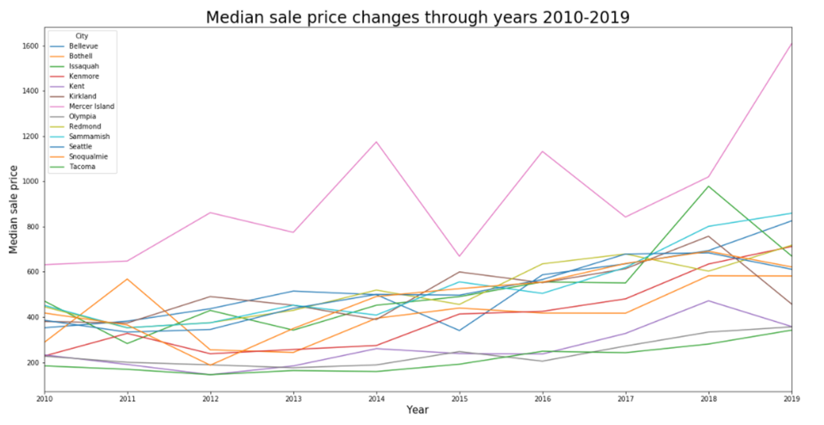
Visualization
Visualization reflecting changes in Median Sale Price for each city throughout the timeline of data (2010-2019).
Observation
Its seen from the visual that City-Mercer Island has the highest sale price throughout but the increase is not consistent. Its price has the highest increase from 2018.
And Tacoma is the least price in 2019

Slide 6
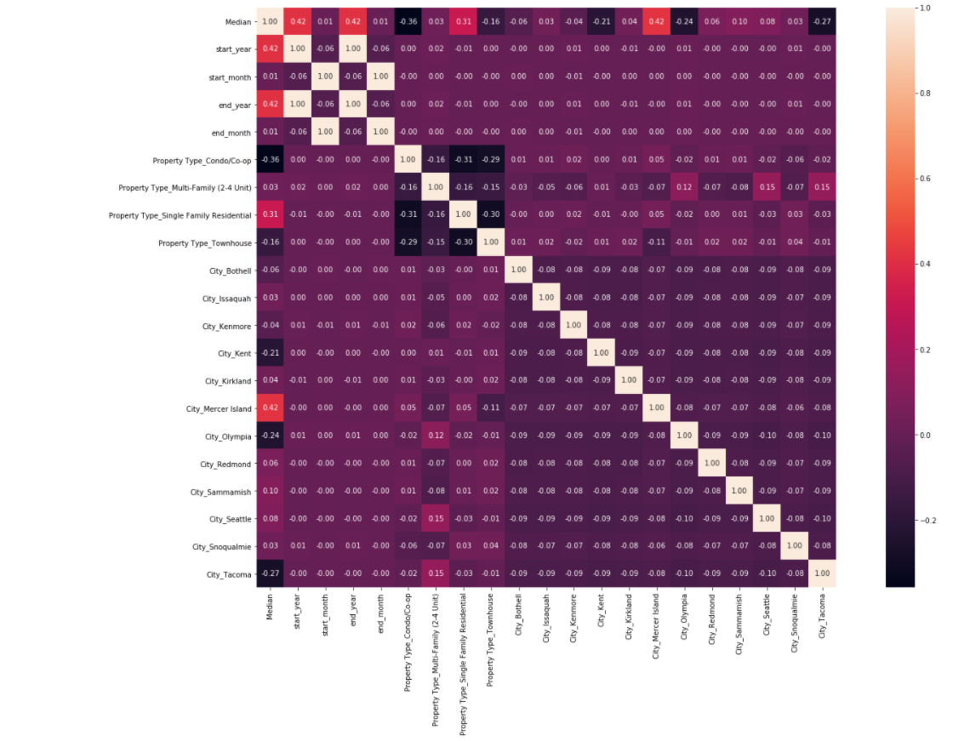
Based on the Heatmap we can observe:
Period Begin Year and Period End Year have medium correlation to Median Sale Price.
Amongst cities, Mercer Island has the highest correlation positive correlation to Median Sale Price
Condo/co-op, City_Tacoma, City_Olympia, City_Kent, Property Type_Townhouse have a negative correlation to Median Sale Price
Months have the lease positive corelation

Slide 7
Preprocessing and transformation
For cleaning of the data first we checked if there is any missing ,duplicates or null values in the dataset, but there were no such values
Data is converted to data type needed for processing
Features are converted to quantitative
From the visuals we found that Median was highly skewed. The skewness can be positive or negative, or undefined. In our case, skewness is positive.

Slide 8
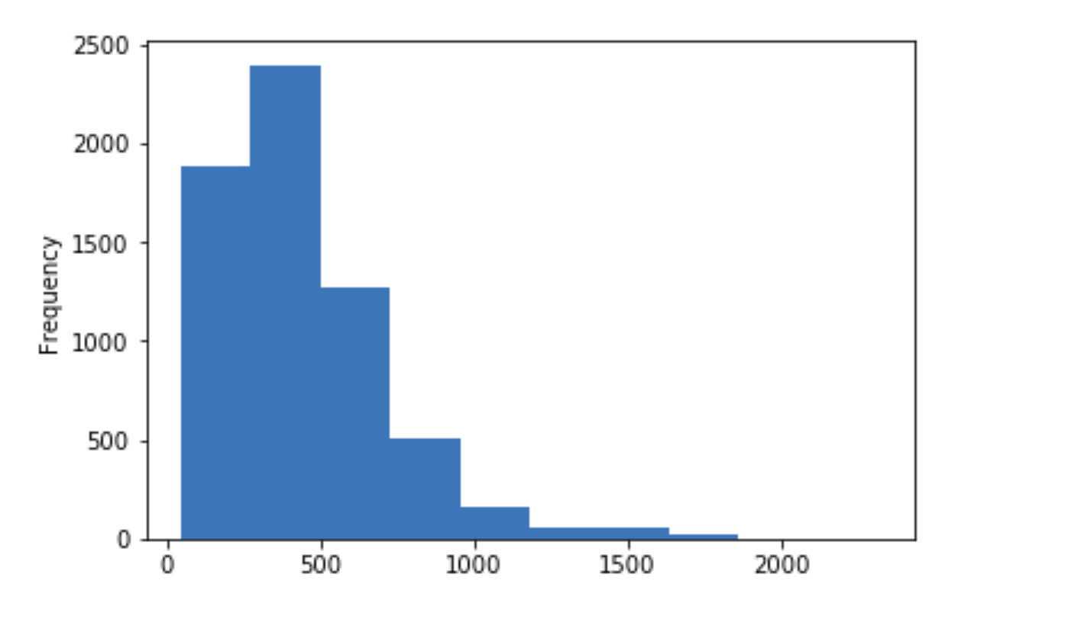
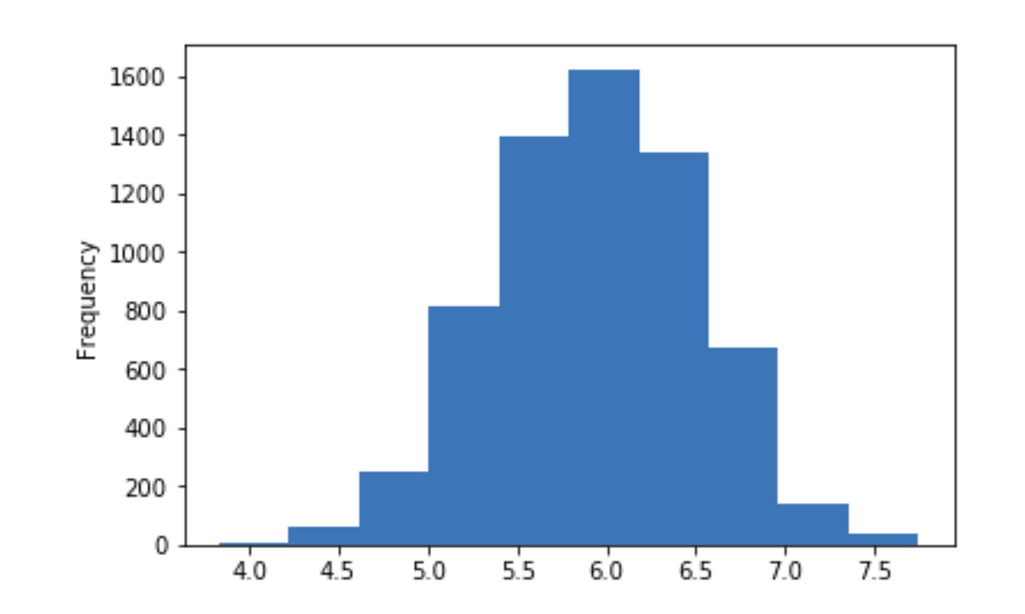
LOG TRANSFORMATION
Its seen that Median is highly skewed.
To overcome the skewness log transformation was done on that feature

Slide 9
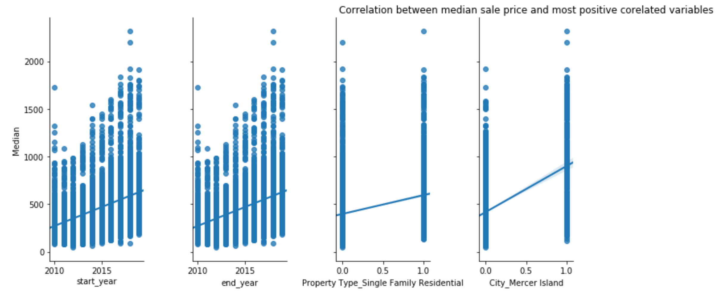
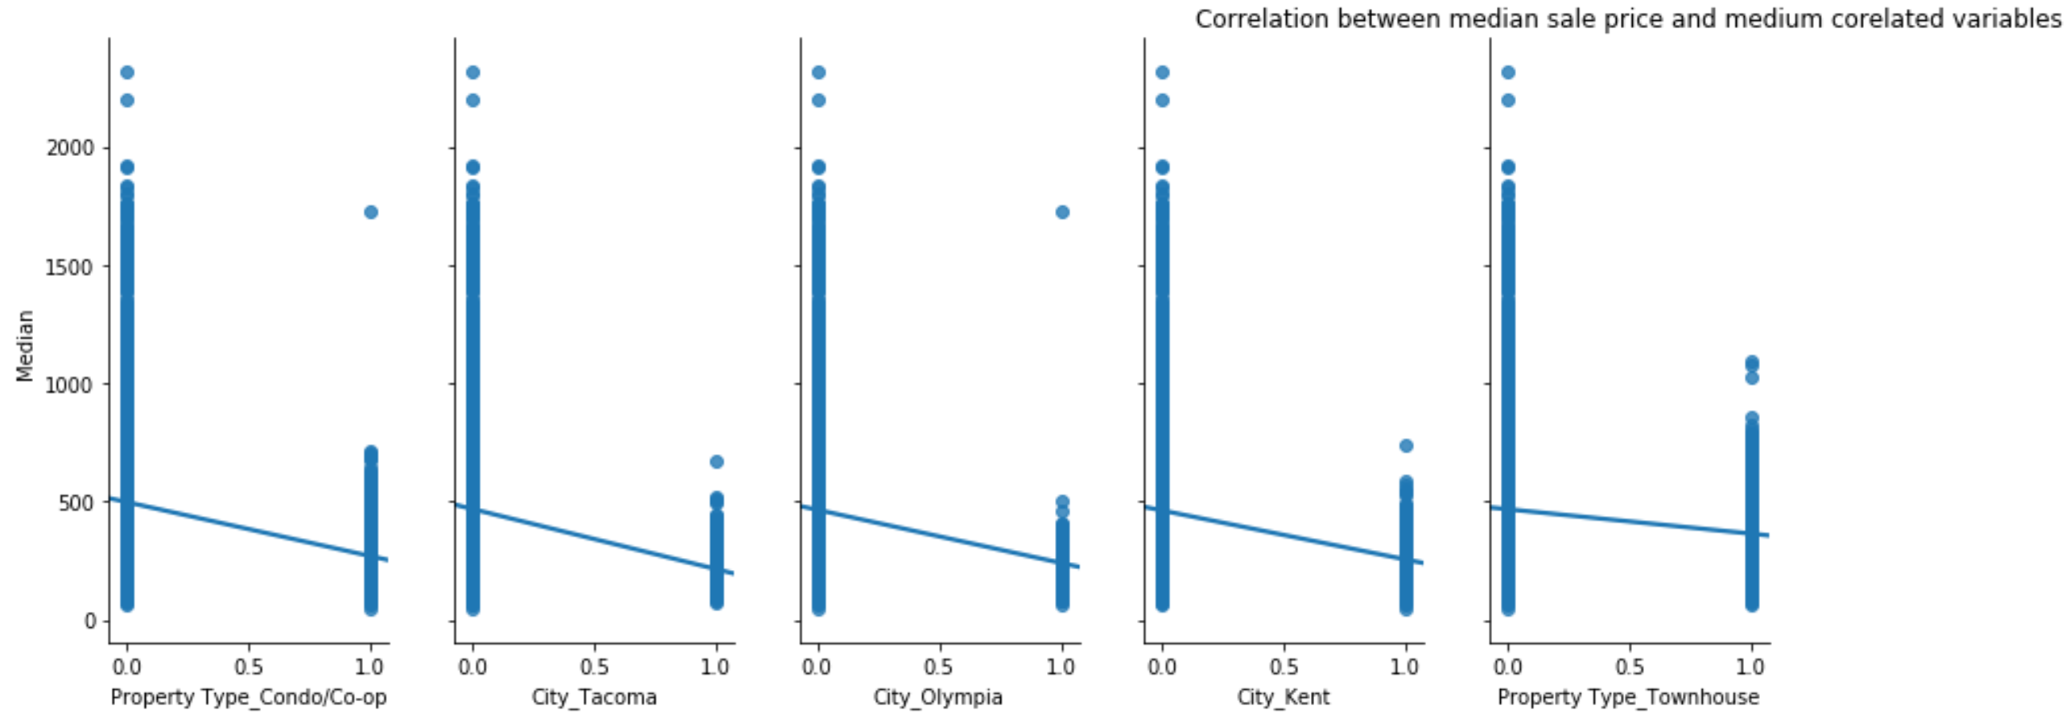
Feature Selection
Filter using Correlation:
To understand the relationship between features we had heat map above. It has the cooefficent value for all feature combinations
We can see all the feature values with respect to median sale price.
Top highest positively correlated features with respect to median sale price and bottom one is the negatively correlated features with respect to median sale price.
After careful analysis of all features values with respect to median , features were selected.

Slide 10
Model Selection
Linear Regression: Selected features whole correlation value is greater than 0.35. R square of this model was low.
Linear Regression with more features: Selected features(18) whose correlation is medium. R square was better than previous.
Linear Regression with more features: selected features(20) whose correlation is low. R square was slightly better than previous.
Ridge Regression: R-squared value was 84
Lasso Regression: R-squared value was 79
Polynomial Regression of degree 3 has R-squared value of 92
Cross Validation is carried out for every model.

Slide 11
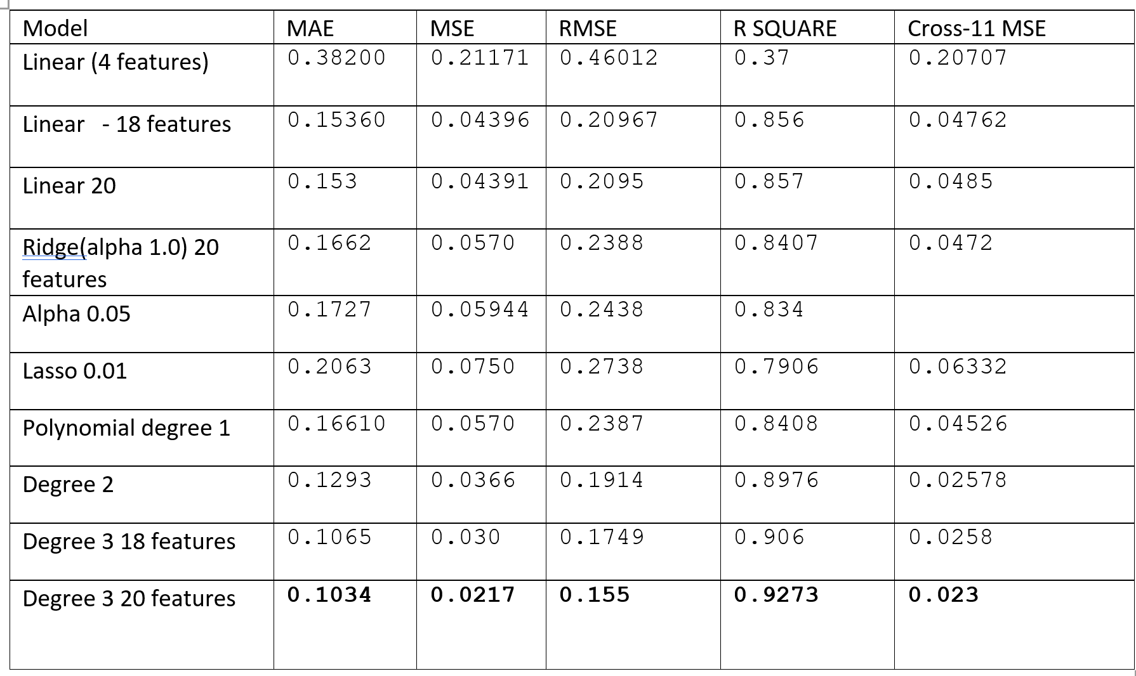
Summary

Slide 12
Best Model and Best features
From above summary its concluded that Polynomial Regression with degree 3 is the best model
Best features are cities, property types, months and year. Features in total:
City_MercerIsland,City_Tacoma,City_Olympia,City_Kent,City_Sammamish,City_Seattle,City_Redmond,City_Bothell,City_Kenmore,City_Kirkland,City_Issaquah,City_Snoqualmie
start_year
end_year
PropertyType_Condo/Co-op, PropertyType_SingleFamily, Residential, Property Type_Multi-Family (2-4 Unit), PropertyType_Townhouse
start_month
end_month

Slide 13
Results and Findings
Findings: Month plays for lesser role but it does increase the accuracy and gives a slight better RMSE value.
Data Preprocessing and Fitting: Used bar and box plots to inspect any outliers in the data. The training and test data is split 80% and 20% respectively for training our model. Compared RMSE values to understand average error, while the accuracy metric was calculated with Mean Absolute error. R-squared value is used as an accuracy measure to interpret overall model performance.
We have used the following metrics in our project: Linear Regression, for optimization we used Lasso and Ridge Regression which reduced the variance in the model and used Polynomial Regression with varying degrees: Degree 1 and Degree 3 with which we wanted to observe if there is a better explanation of the variance with increasing degree of polynomial selected features.
The degree 3 polynomial feature approach outperformed other approaches with a R-squared value of 0.929.

Slide 14
Learnings
Analyzing and preprocessing dataset
Different ways of handling non-numeric columns
Computing useful columns
Implemented different visualizations
Tried various optimizations and evaluated performances

Slide 15
Predictions and Observations:
Observations/Conclusion:
Data Preprocessing and Fitting: Used bar and box plots to inspect any outliers in the data. The training and test data is split 80% and 20% respectively for training our model. Compared RMSE values to understand average error, while the accuracy metric was calculated with Mean Absolute error. R-squared value is used as an accuracy measure to interpret overall model performance.
We have used the following metrics in our project: Linear Regression, for optimization we used Lasso and Ridge Regression which reduced the variance in the model and used Polynomial Regression with varying degrees: Degree 1 and Degree 3 with which we wanted to observe if there is a better explanation of the variance with increasing degree of polynomial selected features.
The degree 3 polynomial feature approach outperformed other approaches with a R-squared value of 0.929.

